Slide 1

WEB DEVELOPMENT
Presentation by K.Niveditha
A23126552026
III/IV CSM-A

Slide 2
Introduction Abstract Objective
Outline
Introduction to HTML and its Applications Introduction to CSS and its Applications Introduction to JavaScript and its Applications Project Overview
System Architecture
Tools used
Features
Output
Future Enhancements
Conclusion

Slide 3
Introduction
Web Development is a vital domain in Computer Science that involves the creation and maintenance of websites,focusing on both structure and interactivity
uring this internship, foundational and advanced concepts of HTML, CSS, and JavaScript were explored to build dynamic and interactive web pages.
.
Web forms were designed and validated using HTML5 and JavaScript to ensure user input integrity and functionality.
JavaScript was also utilized to manage application logic and simulate backend functionalities within the browser environment.
Styling techniques using CSS3, including flexbox and grid systems, were implemented to enhance user interface design and layout consistency.
The internship involved hands-on development of mini-projects such as portfolio pages, interactive forms, tabbed sliders, content, and basic CRUD interfaces without external libraries or frameworks.

Slide 4
Abstract
This report outlines the outcomes of a web development internship focused on front-end and back-end fundamentals using HTML, CSS, and JavaScript.
As part of the internship, a personal Blogging Website was developed, allowing users to sign up, log in, and perform CRUD operations on blog posts.
The blog project emphasized creating a responsive and modern user interface using HTML and CSS, along with dynamic behavior and interactivity powered by JavaScript.
Functionalities included post creation, editing, deletion, and image uploads, along with user authentication and profile management—all without the use of advanced frameworks.

Slide 5
Objective
To gain practical experience in front-end and back-end web development using core technologies such as HTML, CSS, and JavaScript.
To understand and implement the structure and styling of modern web pages using semantic HTML and responsive CSS design principles.
To develop interactive web functionalities using JavaScript, enhancing user experience through DOM manipulation and event handling.
To build a fully functional personal blog project incorporating CRUD (Create, Read, Update, Delete) operations using JavaScript for front-end logic.
To implement user authentication, blog post management, and dynamic UI updates within a cohesive project structure.
To improve knowledge of development workflows and client-server interaction using vanilla JavaScript and modular coding practices.

Slide 6
Introduction to HTML
HTML is the standard markup language used to create web pages
Defines the structure and content of a webpage using tags and elements
Consists of elements like headings, paragraphs, links, images, lists, tables, and forms All web browsers interpret and render HTML to display websites
Works in combination with CSS for styling and JavaScript for interactivity
APPLICATIONS:
Designing the structure of static and dynamic websites
Creating web forms for user input (e.g., contact forms, login pages) Embedding multimedia content such as images, audio, and videos Building email templates for marketing campaigns

Slide 7
Introduction to CSS
CSS is used to style and layout HTML elements on a webpage
Controls colors, fonts, spacing, positioning, and responsiveness Enables separation of content (HTML) and presentation (CSS) Supports selectors, pseudo-classes, and animations
Essential for modern UI design and theming
Used in frameworks like Bootstrap, Tailwind CSS, and Materialize
APPLICATIONS:
Styling websites with colors, layouts, and fonts
Making responsive websites using media queries
Adding animations and transitions for better user experience
Creating themes and skins for Customizing UI in mobile and web frameworks (e.g., Bootstrap, Tailwind CSS)

Slide 8
Introduction to Java Script
JavaScript is a scripting language used to create dynamic and interactive web pages
Executes on the client side within the browser
Controls webpage behavior such as form validation, animations, and event handling Lightweight and interpreted, making it fast and flexible
Works seamlessly with HTML and CSS to enhance UI/UX
Supports popular frameworks like React, Vue, and Angular Follows object oriented and event-driven programming principles
Widely used in both frontend and backend development (e.g., with Node.js)
APPLICATIONS:
Adding interactivity (form validation, dropdowns, sliders)
Manipulating HTML and CSS dynamically using DOM
Developing single-page applications (SPAs)
Powering backend development through Node.js

Slide 9

Project Overview
Features: User registration, login/logout, create/edit/delete blog posts
Used MongoDB, Express.js, and Node.js for the backend Frontend designed using HTML, CSS, and JavaScript with a modern layout
CRUD operations allowed users to manage their own blog posts dynamically
Implemented image upload support for blog posts using Multer Created a user-specific dashboard with post management and profile display
Developed a home screen landing page with a visual entry point to the blog
Ensured session-based authentication and secure routing for logged-in users

Slide 10
System Architecture
Built using HTML, CSS, JavaScript
Dynamic dashboard UI for post creation, viewing, editing, and deletion Displays blog content and handles user input
Frontend(Client side)
Express.js and Node.js
Handles all routes for: User authentication (/signup, /login, /logout) Blog management (/create, /edit/:id, /delete/:id)
File upload (image support via Multer middleware) Controls access using session-based login
Backend
Mongodb with Mongoose
Stores: User data (name, email, password hash) Blog posts (title, content, image path, author) Timestamps, references for data linkage
Database

Slide 11
Tools Used
HTML, CSS, JavaScript – Built the frontend layout, styling, and interactions
Node.js with Express.js – Handled server-side logic and routing
MongoDB with Mongoose – Stored user data, blog posts, and image paths Multer – Handled file uploads (user blog images)
EJS / HTML templates – Rendered dynamic content in the frontend Bootstrap – Used for responsive design and grid layout
VS Code – Used for full project development
MongoDB Atlas – Hosted the database on the cloud for real-time access

Slide 12
Features
User Authentication: Secure signup and login functionality with session management.
Create & Publish Blog Posts: Users can share their wellness experiences with title, content, and images.
Image Upload Support: Allows bloggers to visually enhance their posts with relevant images.
Responsive Dashboard: Modern, user-friendly dashboard to manage blog posts easily.
Edit & Delete Posts: Authenticated users can modify or remove their own blog entries.
Profile View: Each user has a dedicated profile displaying their published blogs.
MongoDB Integration: All data is stored securely in MongoDB for scalability and performance.
Clean UI with Bootstrap Styling: Visually appealing and consistent interface for a pleasant user experience.

Slide 13
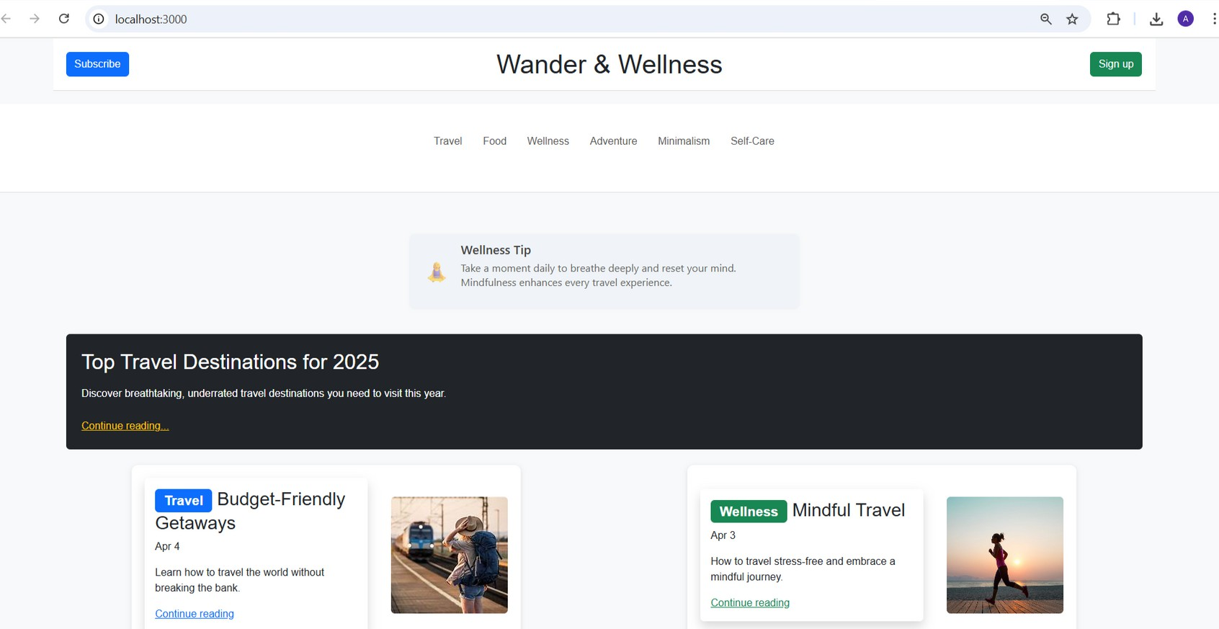
Output

Slide 14
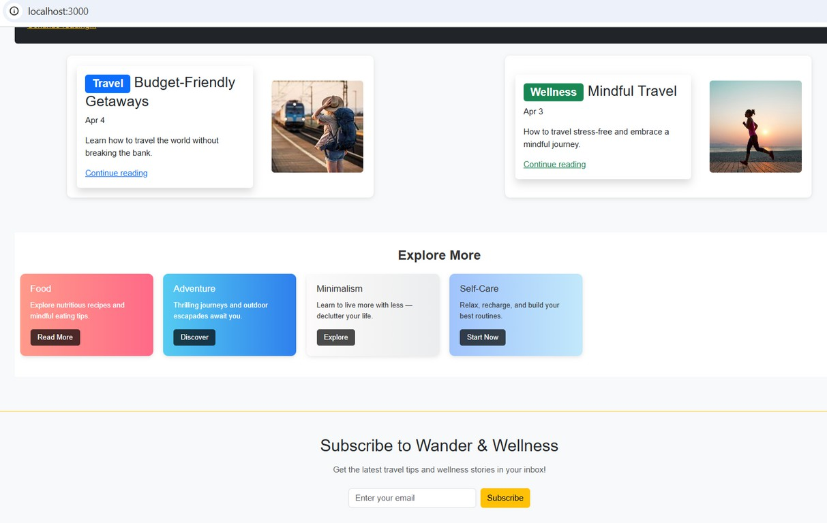
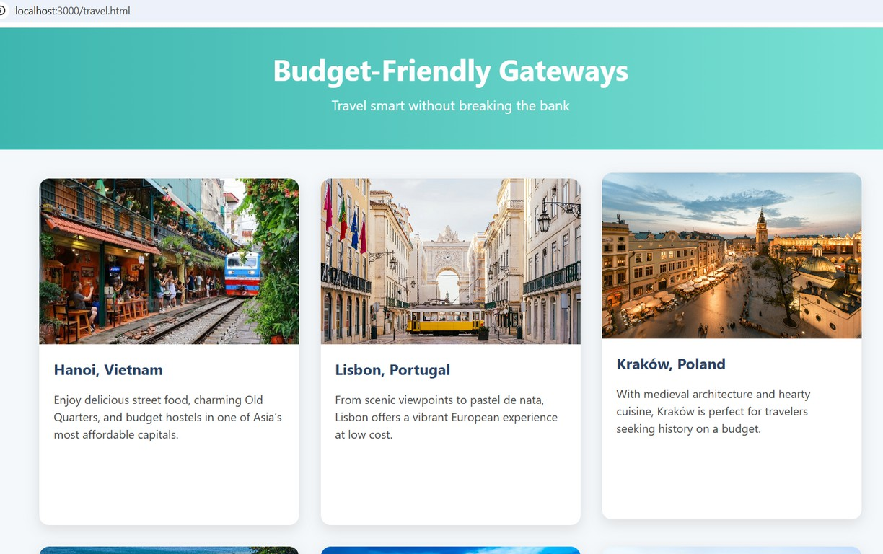

Slide 15
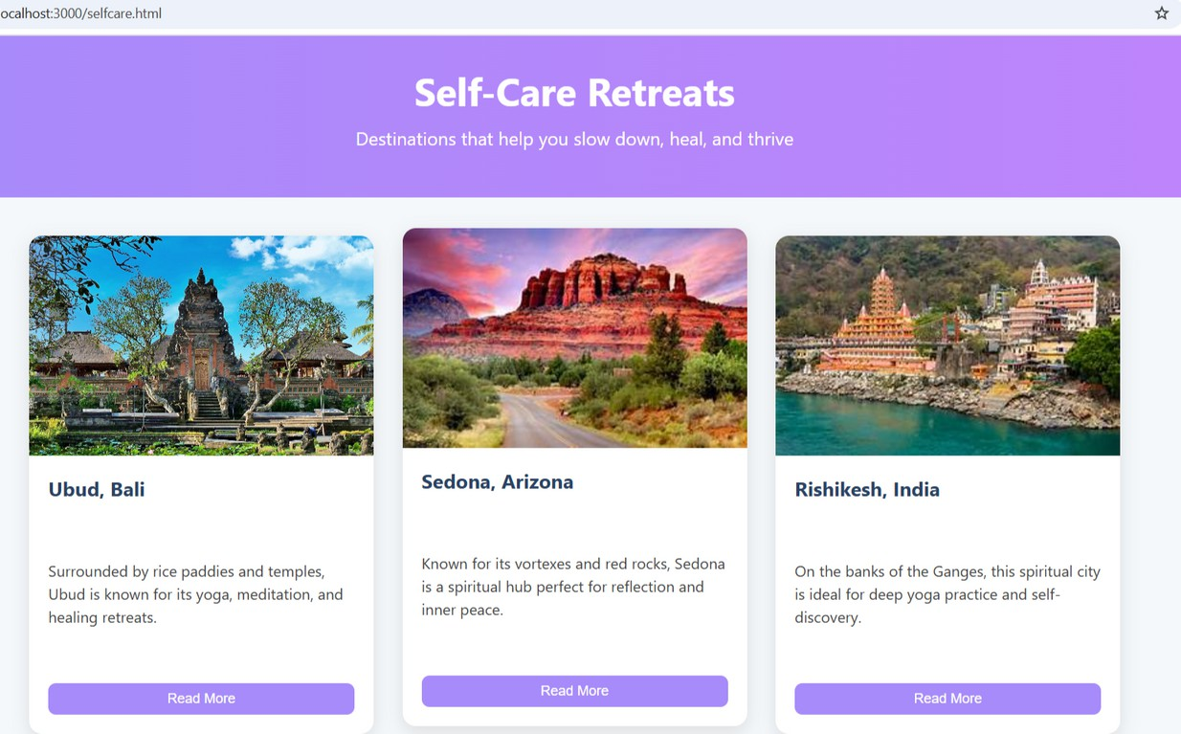
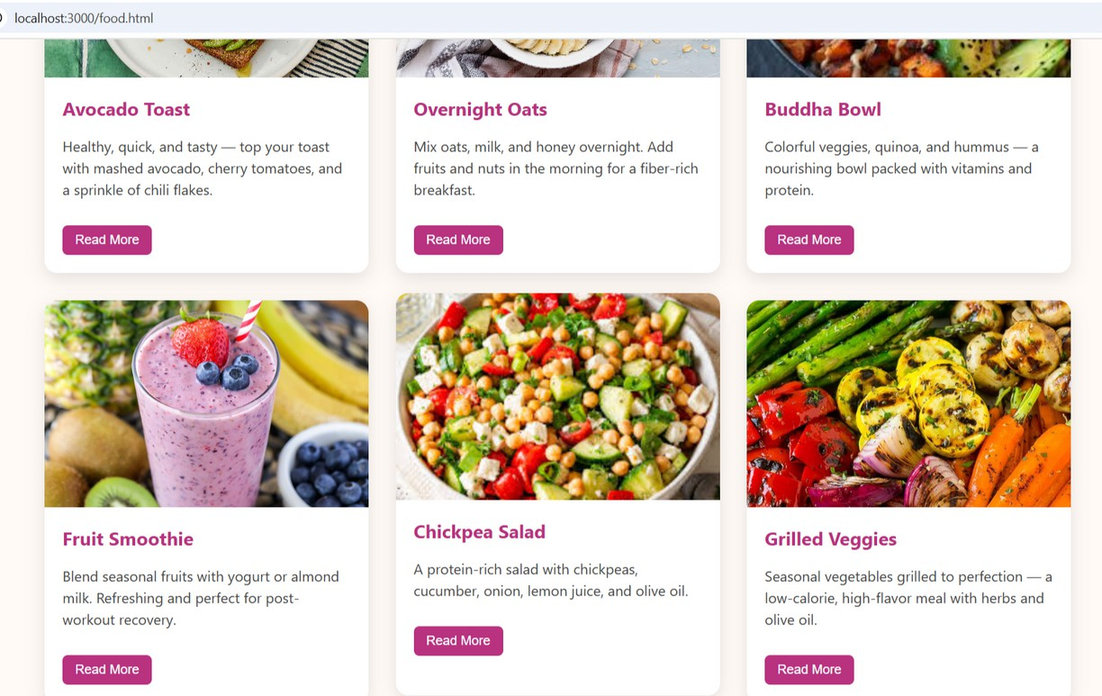

Slide 16
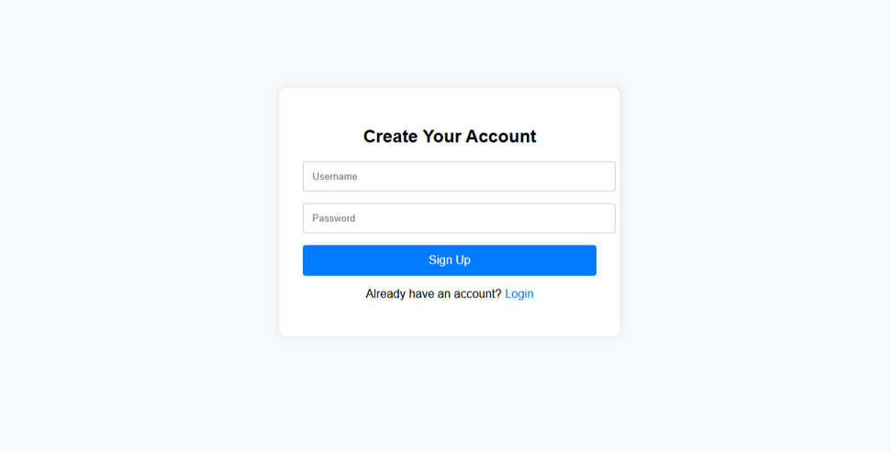
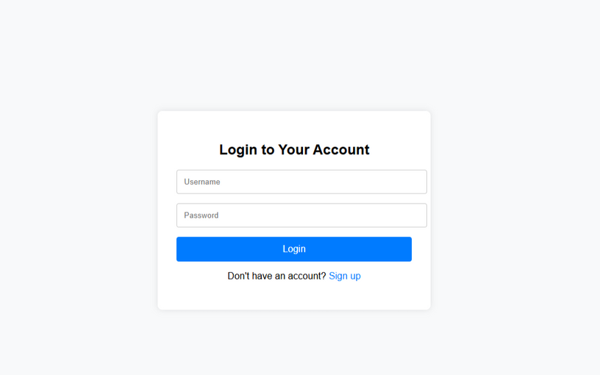
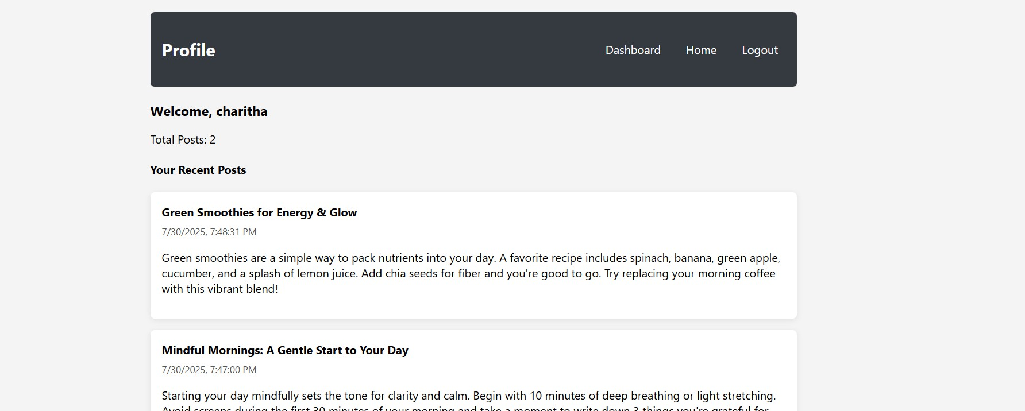

Slide 17
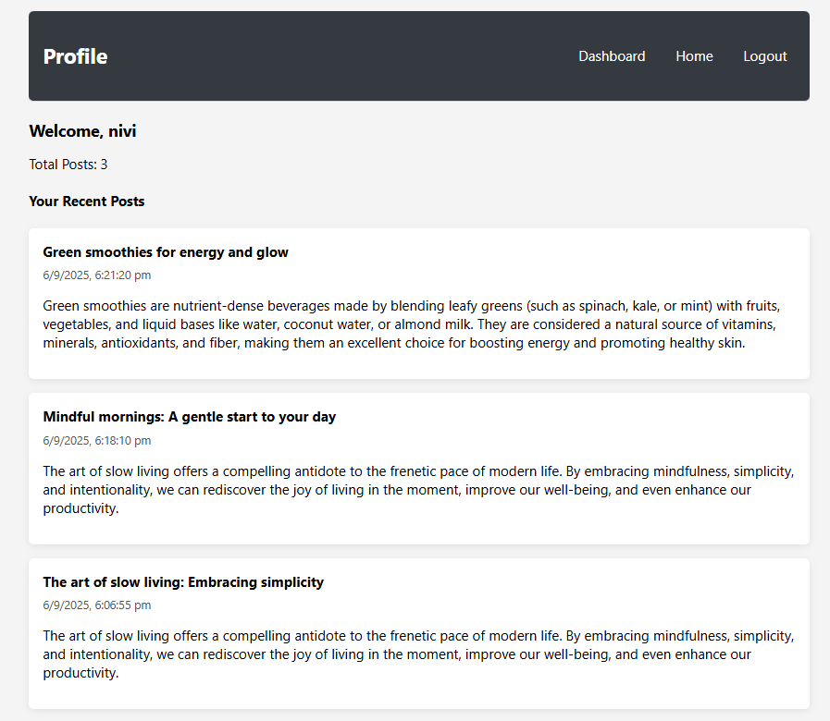

Slide 18
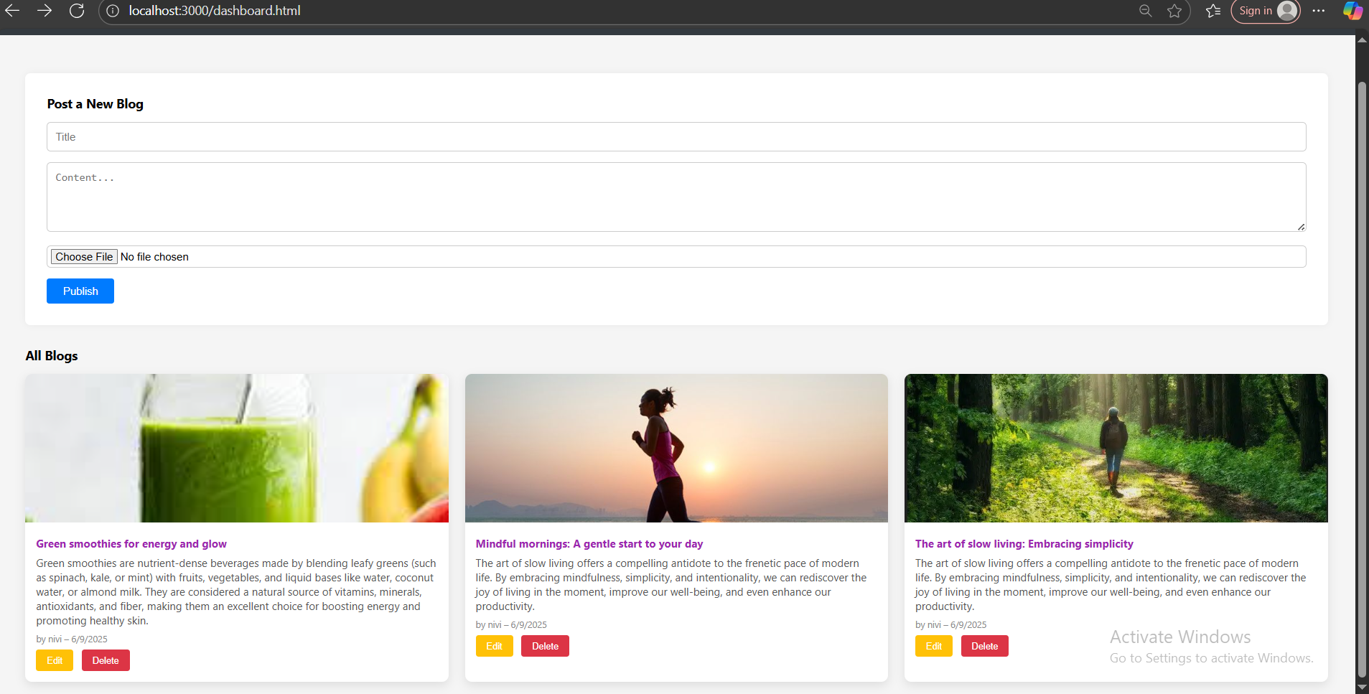

Slide 19
Future Enhancements
User Comments & Likes: Enable users to interact with blog posts through comments and like buttons.
Search and Filter Feature: Implement search functionality to find posts by title, tags, or author.
Email Notifications: Send notifications to users for new posts, comments, or updates.
Mobile App Integration: Extend the platform to a mobile version for on-the-go wellness access.
Dark Mode Toggle: Add a theme switcher for improved user experience and accessibility. Admin Dashboard: Provide admins with insights, analytics, and content moderation tools. User Following System: Allow users to follow others and get a personalized feed.

Slide 20

Conclusion
The Wander and Wellness blog project successfully integrates modern full-stack technologies to deliver a dynamic and user-friendly blogging platform.
It demonstrates web development using MongoDB, Express.js, Node.js, and EJS, enabling user authentication, blog post creation with image uploads, and seamless content rendering.
Through this project, practical experience was gained in areas such as RESTful API design, session-based authentication, file handling with Multer, CRUD operations using Mongoose, and template-based UI rendering.
The platform encourages creative expression and mindful living, providing users with a space to share travel stories, wellness tips, and personal reflections.
Overall, this project enhanced both backend and frontend development skills, offering a strong foundation for building scalable and interactive web applications.

Slide 21
THANK YOU

